Slide 1

Identifying Vaccine Misinformation

Slide 2
Looking at All the Facts
Notes:
We should get in the habit of thinking about the statements we see in the news and the Internet.
Ask, "Does this give me information I can interpret and act on? Does it open the door to more questions?"

Slide 3
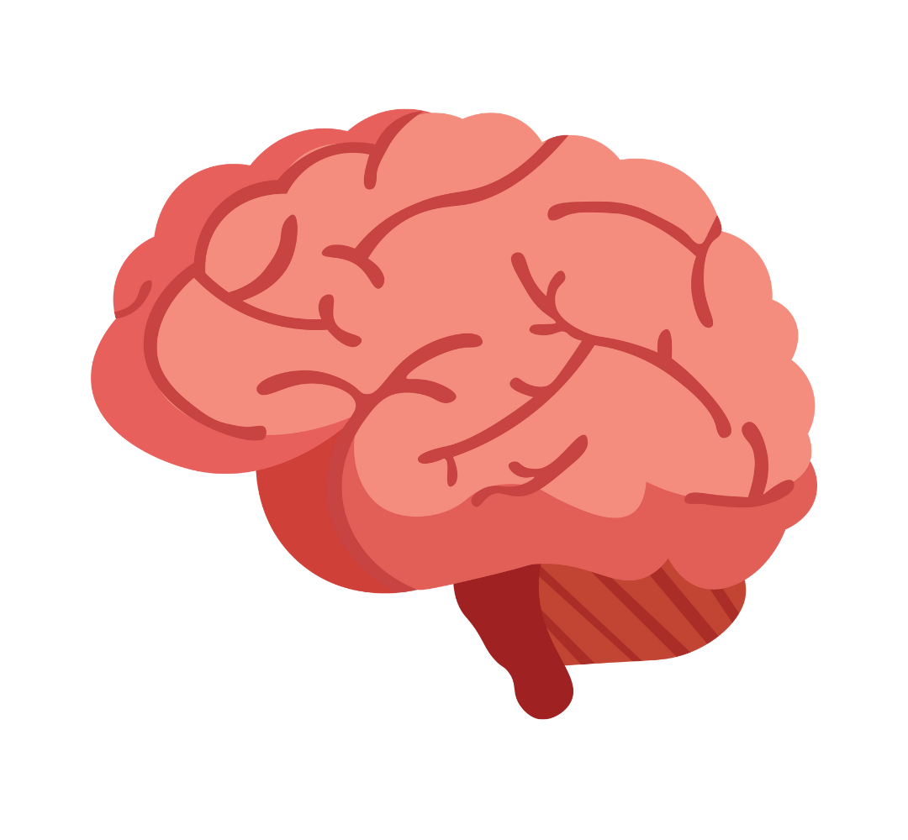

Four Key Facts
Here are two statements that we made up...just out of thin air:
22 people with brain tumors state they "definitely" carried a cell phone for years.
61% of people with cancer were found to have arthritis, too.
Notes:
Here are two statements that we made up...just out of thin air:
22 people with brain tumors state they "definitely" carried a cell phone for years.
61% of people with cancer were found to have arthritis, too.
Sometimes an alarming statement like this makes it into the news. Even if they were facts (again, they're NOT facts...we made them up) these statements are not useful. They don't help us understand if a particular exposure (cell phone, arthritis) is at all related to the problem.

Slide 4
Four Key Facts
Here are two statements that we made up...just out of thin air:
22 people with brain tumors state they "definitely" carried a cell phone for years.
61% of people with cancer were found to have arthritis, too.
Sometimes an alarming statement like this makes it into the news. Even if they were facts, these statements are not useful. They don't help us understand if a particular exposure (like a cell phone) is at all related to the problem.
Notes:
Here are two statements that we made up...just out of thin air:
22 people with brain tumors state they "definitely" carried a cell phone for years.
61% of people with cancer were found to have arthritis, too.
Sometimes an alarming statement like this makes it into the news. Even if they were facts (again, they're NOT facts...we made them up) these statements are not useful. They don't help us understand if a particular exposure (cell phone, arthritis) is at all related to the problem.

Slide 5
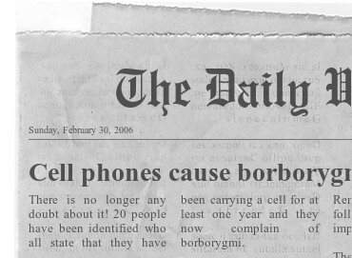

Example
Let’s use a fictional example.
Borborygmi is not really a disease, but it sounds like one. Let's imagine that in the news I read that 20 people with cell phones got borborygmi.
Do people with cell phones have a higher chance of developing borborygmi than people without cell phones?
Notes:
Let’s use a fictional example.
Borborygmi is not really a disease, but it sounds like one. Let's imagine that in the news I read that 20 people with cell phones (the exposure) got borborygmi (the disease).
Well, that seems alarming if I carry a cell phone and don't want borborygmi.
Do people with cell phones have a higher chance of developing borborygmi than people without cell phones?

Slide 6
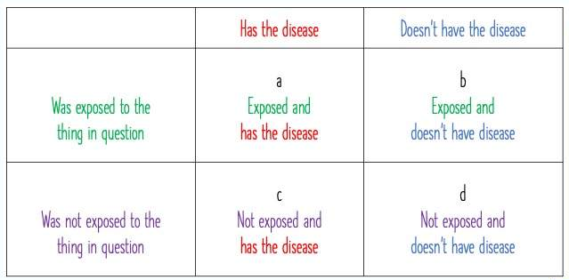
To begin addressing this question...
To begin addressing this question, we need 4 pieces of information from a randomly selected population.
The green row: Among those with a cell phone, what proportions
  (1) Have the disease?
  (2) Do not have the disease?
Notes:
4 key facts
To begin addressing this question, I need 4 pieces of information from a randomly selected population:
The green row: Among those with a cell phone, what proportions
Have the disease?
Do not have the disease?
The purple row: Among those who do not have a cell phone, what proportion
Have the disease?
Do not have the disease?

Slide 7
To begin addressing this question...
To begin addressing this question, we need 4 pieces of information from a randomly selected population.
The purple row: Among those who do not have a cell phone, what proportions
  (3) Have the disease?
  (4) Do not have the disease?
Notes:
4 key facts
To begin addressing this question, I need 4 pieces of information from a randomly selected population:
The green row: Among those with a cell phone, what proportions
Have the disease?
Do not have the disease?
The purple row: Among those who do not have a cell phone, what proportion
Have the disease?
Do not have the disease?

Slide 8

The news only gave us 1 fact
Disease among those "exposed" to cell phones:
20 people with cell phones got borborygmi.
Right now, only one box is complete.
Notes:
The news only gave me 1 fact
Disease among those "exposed" to cell phones
Right now, only one box is complete.
There are three possible outcomes

Slide 9

Possibility #1: No difference seen
It may be that if we checked 100 (randomly selected) people,
we'd find this.
Hypothesis: Exposure to the cell phone did not make a difference to their chance of having the disease.
Notes:
No difference seen
It may be that if I checked 100 (randomly selected) people, I’d find this.
This table leads me to hypothesize that -- whether or not the person was exposed to the thing in question (having a cell phone) -- it did not make a difference to their chance of having the disease.

Slide 10
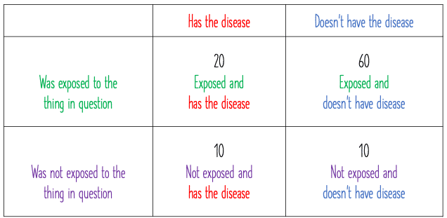
Possibility #2: Possible protective effect
It may be that if we checked 100 (randomly selected) people,
we'd find this.
Hypothesis: People exposed to having a cell phone were LESS likely to have the disease.
Notes:
Possible protective effect
It may be that if I checked 100 (randomly selected) people, I’d find this.
This table leads me to hypothesize that people exposed to the thing in question (having a cell phone) were LESS likely to to have the disease.

Slide 11

Possibility #3: Danger Signal
It may be that if we checked 100 (randomly selected) people,
we'd find this.
Hypothesis: People exposed to the cell phone were MORE likely to have the disease.
Notes:
Danger signal
And finally, it may be that if I checked 100 (randomly selected) people, I’d find this.
This table leads me to hypothesize that people exposed to the thing in question (having a cell phone) were MORE likely to to have the disease.

Slide 12
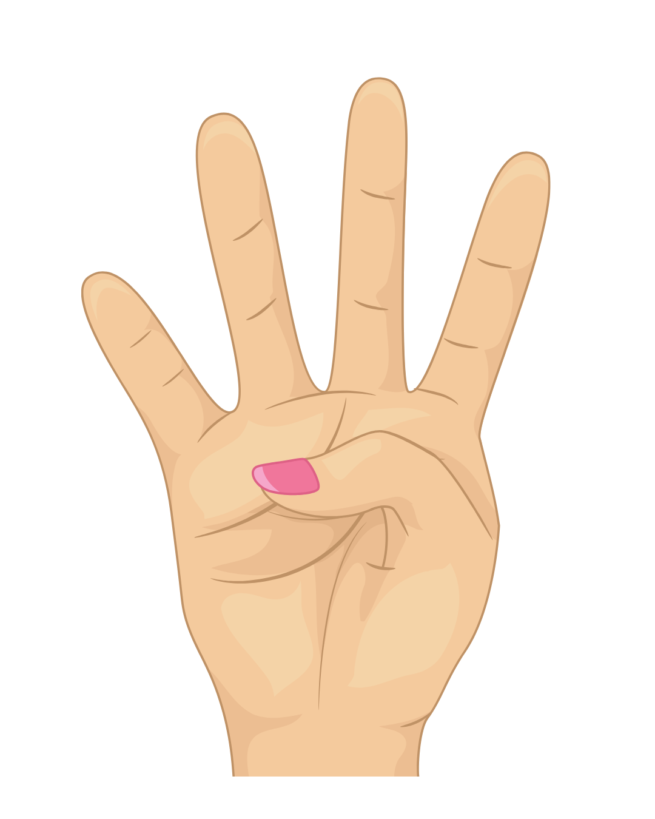
Key Point
Whether or not an exposure affects the likelihood of a condition requires four key pieces of information.
If we don't have all four pieces of information, we are still in what might be called the "speculation phase."
Notes:
An early understanding whether an exposure (such as a cell phone or a vaccine) increases or decreases the likelihood of a condition (such as borborygmi or autism) requires four key pieces of information. If we don't have all four pieces of information, we are still in what might be called the "speculation phase."

Slide 13
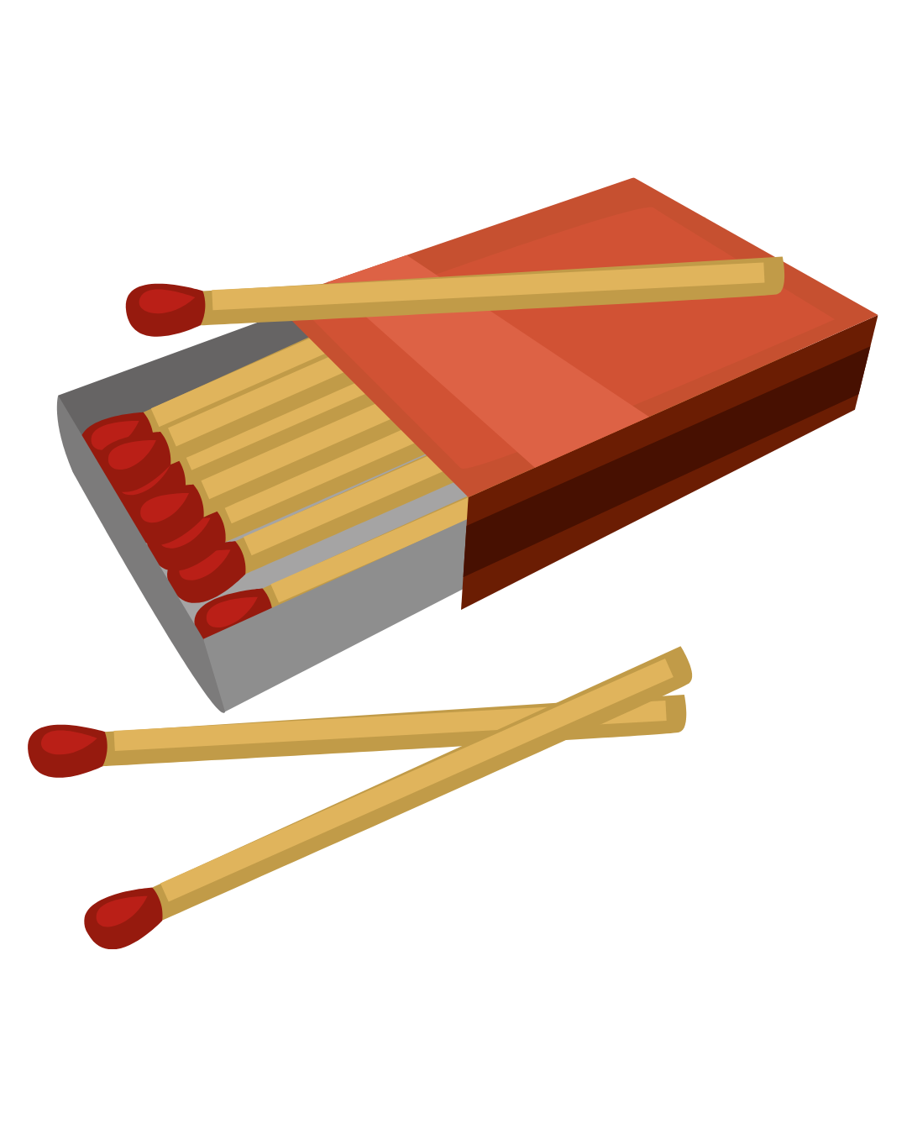
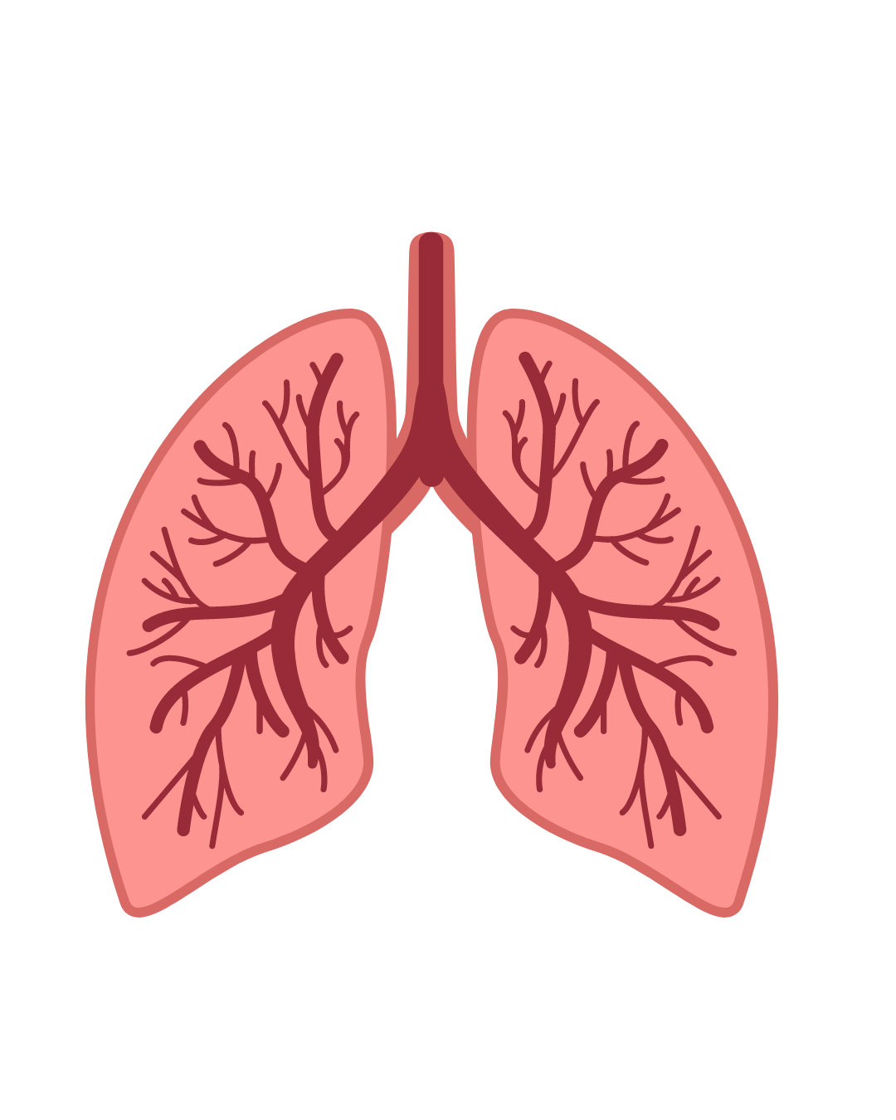
Confounding Factors
Let's imagine that you read a story talking about a study that shows: Men who carried matches in their pocket are more likely to develop lung cancer.
Matches are made of an oxidizing agent, mixed with sulfur, fillers and glass powder.
The reporter implies that there might be something about one of these ingredients that causes lung cancer and concludes that the findings "are very controversial."
Notes:
Let's imagine that you read a story talking about a study that shows: "Men who carried matches in their pocket are more likely to develop lung cancer."
Matches are made of an oxidizing agent, mixed with sulfur, fillers and glass powder.
The reporter implies that there might be something about one of these ingredients that causes lung cancer and concludes that the findings "are very controversial."

Slide 14

Consider this…
In your opinion, which of the following is the most likely reason that, "Men who carried matches in their pocket are more likely to develop lung cancer"​?
  The cancer was caused by touching the oxidizing agent​
  The cancer was caused by touching the glass powder​
  People who carry matches in their pocket are more likely to smoke and smoking causes lung cancer
Notes:
In your opinion, which of the following is the most likely reason that, "Men who carried matches in their pocket are more likely to develop lung cancer." In your opinion, which of the following is the most likely reason that, "Men who carried matches in their pocket are more likely to develop lung cancer."
The cancer was caused by touching the oxidizing agent
The cancer was caused by touching the glass powder
People who carry matches in their pocket are more likely to smoke and smoking causes lung cancer

Slide 15


Consider this…
In your opinion, which of the following is the most likely reason that, "Men who carried matches in their pocket are more likely to develop lung cancer"​?
  The cancer was caused by touching the oxidizing agent​
  The cancer was caused by touching the glass powder​
  People who carry matches in their pocket are more likely to smoke and smoking causes lung cancer
Notes:
Right! The most likely explanation is that people who carry matches in their pocket are likely to smoke and smoking causes lung cancer.

Slide 16
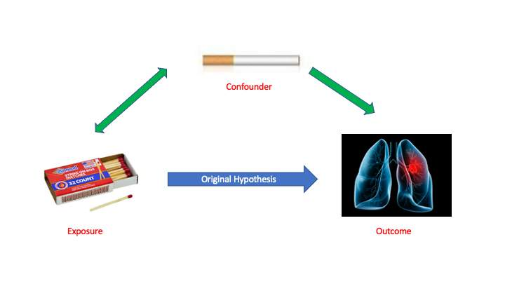
Confounders
A confounder is a factor that influences both the exposure and the disease.
Notes:
A confounder is a factor that influences both the "exposure" (in this case, carrying matches) and the "disease" (lung cancer).

Slide 17
Confounders
A confounder can fool us by making it seem like the exposure causes the disease.
Notes:
A confounder is a factor that influences both the "exposure" (in this case, carrying matches) and the "disease" (lung cancer).

Slide 18
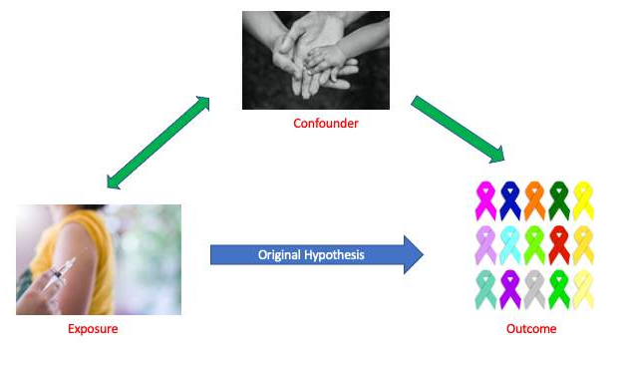
Confounders
Here's a vaccine example:
A study shows that there are more cases of cancer reported now than before vaccines were first invented.
The writer concludes that vaccines cause cancer.
Can you think
of another interpretation?
Notes:
A confounder can fool us by making it seem like the exposure (e.g., carrying matches) causes the disease (e.g., lung cancer).
Here's a vaccine example. A study shows that there are more cases of cancer reported now than before vaccines were first invented. The writer concludes that vaccines cause cancer.
Can you think of another interpretation?

Slide 19
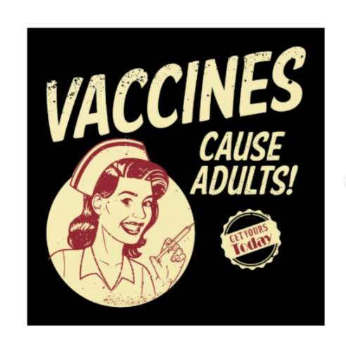

Confounding Factors with Vaccines
There is a confounding factor that has been ignored.
Fact: Childhood vaccinations increase the chance of surviving into adulthood.
Fact: Adults are much more likely to have cancer.
Vaccines increase the chance that our lives will be long enough to get cancer.​
Notes:
There is a confounding factor that has been ignored.
Fact: childhood vaccinations increase the chance of surviving into adulthood.
Fact: adults are much more likely to have cancer
Vaccines increase the chance that our lives will be long enough to get cancer.

Slide 20


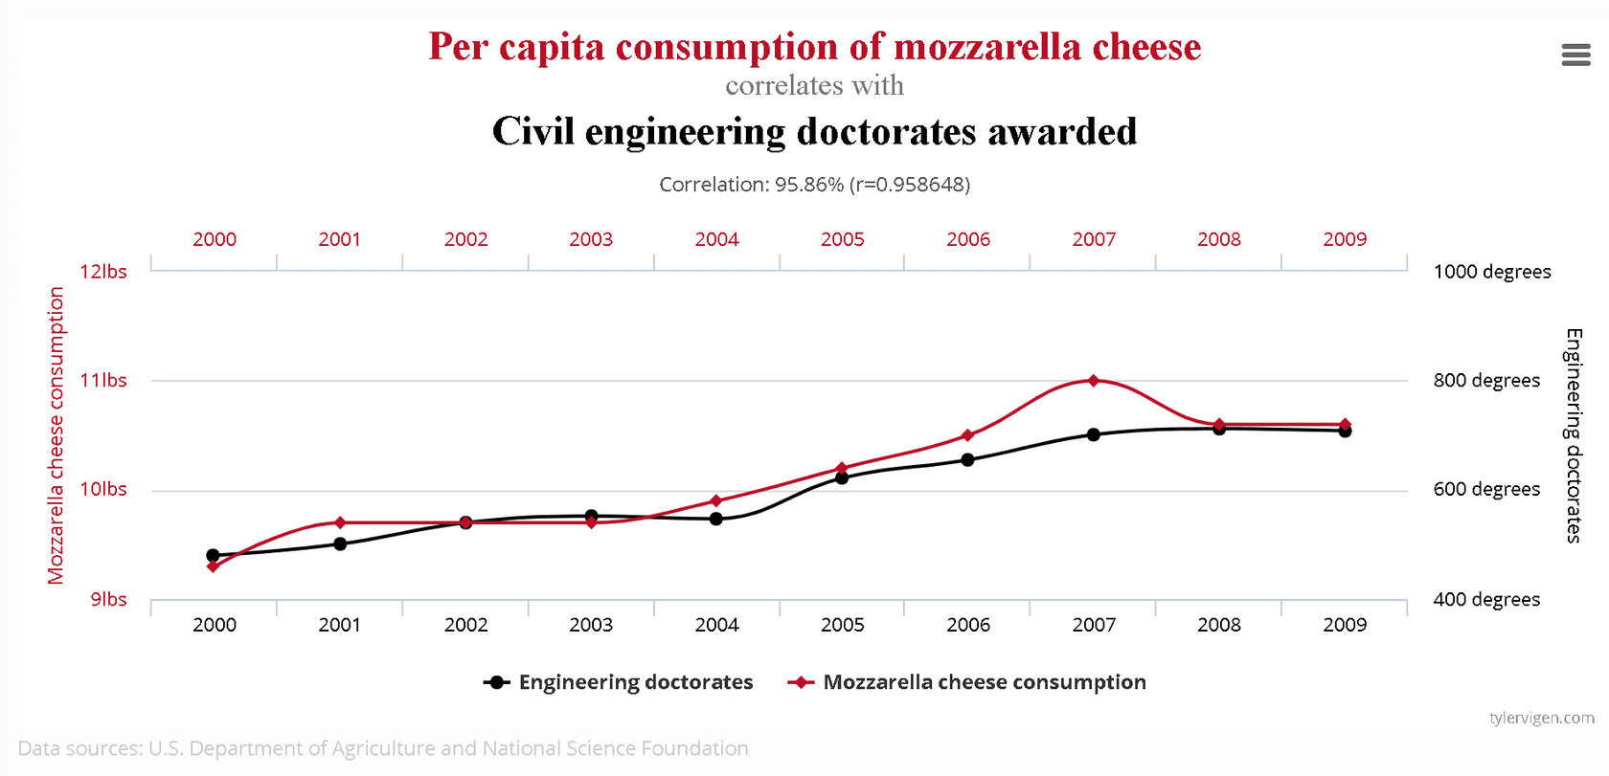
Some things happen by chance
Two things may change together over time without being related.
Notes:
Look at the silly graph below.
We all know the "per capita consumption of mozzarella cheese" is not influenced by the number of "civil engineering doctorates awarded."
Two things may change together over time without being related.

Slide 21
Avoiding False Dichotomies and False Balance

Slide 22
False Dichotomy
Definition: A situation in which two alternative points of view are presented as the only options, when others are available.
Notes:
A false dichotomy (plural: false dichotomies) is a situation in which two alternative points of view are presented as the only options, when others are available.

Slide 23

Example of a False Dichotomy
I must reject science and medicine because I am religious.
This argument presents a false split – as if belief in science and belief in religion are incompatible.
You don’t have to make a choice between the two; they are not mutually exclusive.
Notes:
Here is an example: I have to reject science and medicine because I am religious.
This argument presents a false split -- as if belief in science and belief in religion were exclusive and incompatible. Some specific religious and scientific claims may conflict, but most are compatible with each other.
You don’t have to make a choice between the two; they are not mutually exclusive.

Slide 24
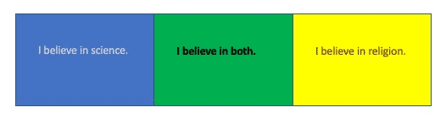
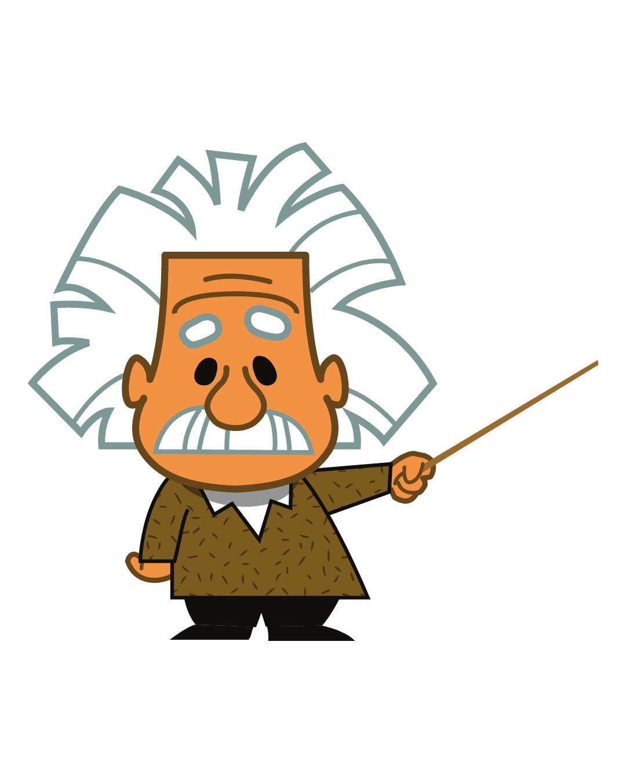
Rethink False Dichotomies
In our example, it is possible to believe that God created the universe, and that the universe operates according to natural laws that are discoverable by science.
In fact, several great scientists (including Einstein) believed in God.
Notes:
Rethink false dichotomies.
In our example, it is possible to believe that God created the universe and that the universe operates according to natural laws that are discoverable by science. God could be the entity that created the laws that govern the universe.
In fact, several great scientists (including Einstein) believed in God.

Slide 25

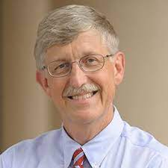
"One of the greatest tragedies of our time is this impression that has been created that science and religion have to be at war."
Francis Collins
American physician-geneticist
Notes:
Francis Collins, American physician-geneticist
He discovered the genes associated with a number of diseases and led the Human Genome Project. He is director of the U.S. National Institutes of Health (NIH)

Slide 26

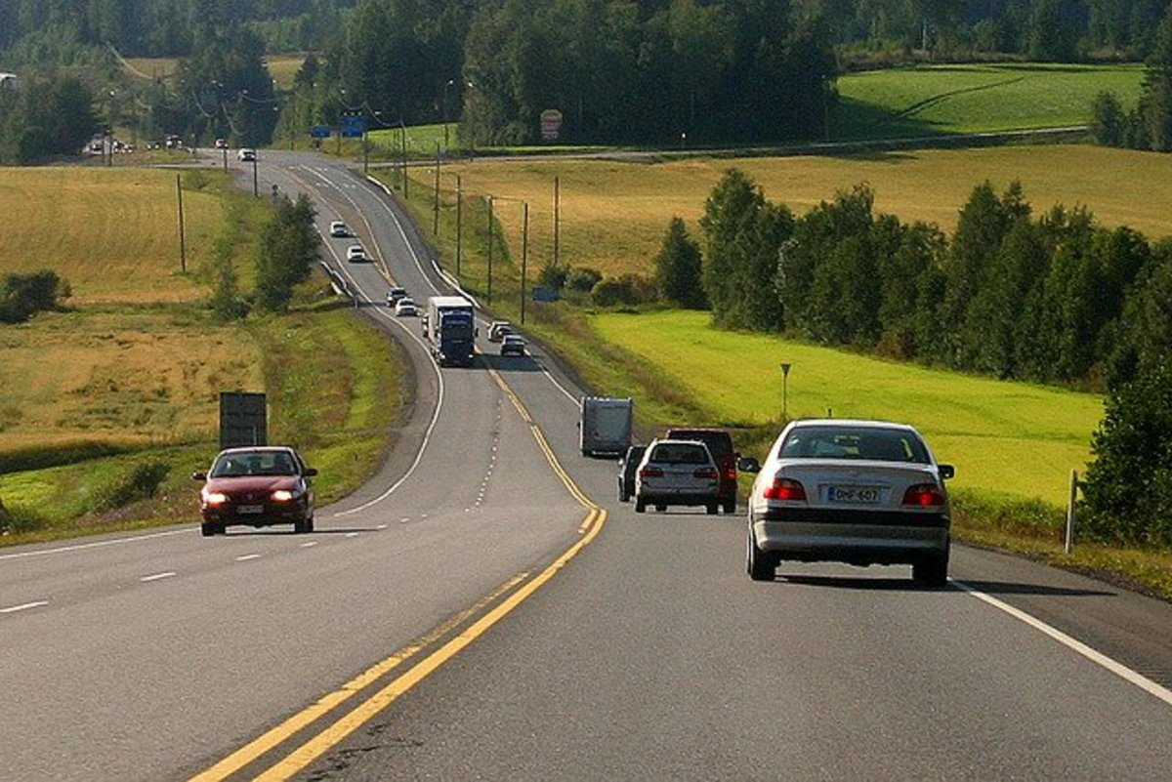
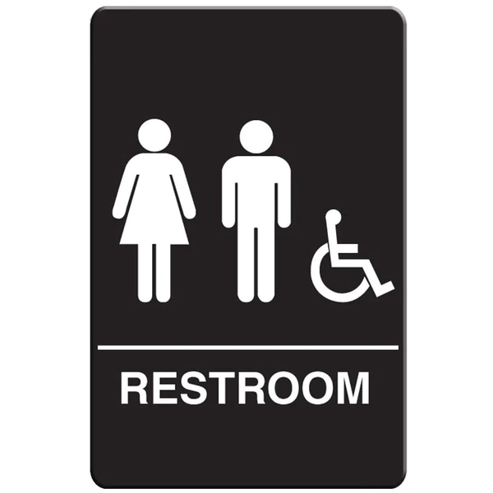
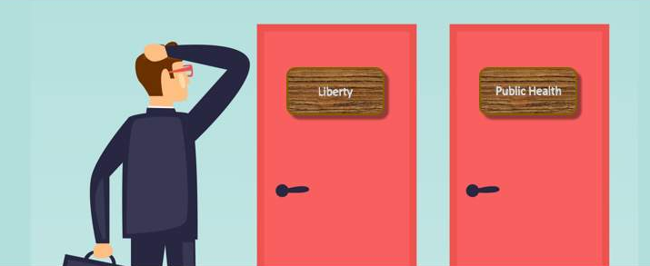
Another example of a false dichotomy?
When we live together in communities, we agree to follow certain rules for our mutual safety, such as stopping a red lights, driving on the right side of the road, and using designated places for elimination (i.e., restrooms).
The choice to have children vaccinated before they attend school is like the other community rules.
Notes:
When we live together in communities, we agree to follow certain rules for our mutual safety, such as stopping a red lights, driving on the right side of the road, and using designated places for elimination (i.e., restrooms).
The choice to have children vaccinated before they attend school is like the other community rules.

Slide 27
Discussion
Can you think of other false dichotomies?

Slide 28
Do you see either of these as false dichotomies?
I am not having my child vaccinated because I don't want their immune system invaded by something foreign.
The government is too big so I'm going to oppose it by not having my child vaccinated.

Slide 29
Who benefits from false dichotomies?
Notes:
often, it's people who want a controversy.

Slide 30

Who benefits from false dichotomies?
Often, it's people who want a controversy.
Notes:
often, it's people who want a controversy.

Slide 31
Avoiding False Balance

Slide 32
False Balance
Definition: False balance is a media bias in which journalists present an issue as being more balanced between opposing viewpoints than the evidence supports.
False balance has been credited with spreading misinformation.
Notes:
Definition: (from Wikipedia) False balance, also bothsidesism, is a media bias in which journalists present an issue as being more balanced between opposing viewpoints than the evidence supports.
Journalists may present evidence and arguments out of proportion to the actual evidence for each side, or may omit information that would establish one side's claims as baseless. False balance has been credited with spreading misinformation.

Slide 33
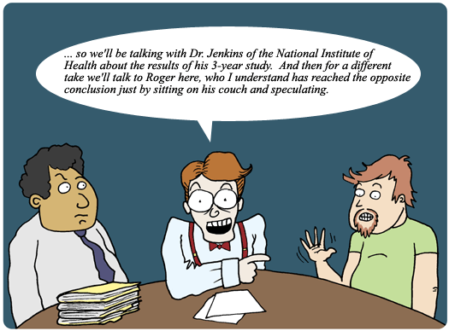
Notes:
Some news stories present "both sides" -- even if the sides do not represent equal evidence or equal numbers of people.
Is this out of the desire for fairness or the desire to generate public interest with controversy? We cannot know.
When someone is included in a media report and he/she takes a stance on vaccines that is not based on fact, the report can do harm in two ways.

Slide 34
Harms of False Balance
When someone in a media report takes a stance on vaccines that is not based on fact, the report can do harm in two ways:
Giving invalid or vague ideas equal weight to verifiable scientific facts.
Allowing the social controversy to seem larger than it actually is.
Notes:
Some news stories present "both sides" -- even if the sides do not represent equal evidence or equal numbers of people.
Is this out of the desire for fairness or the desire to generate public interest with controversy? We cannot know.
When someone is included in a media report and he/she takes a stance on vaccines that is not based on fact, the report can do harm in two ways.

Slide 35
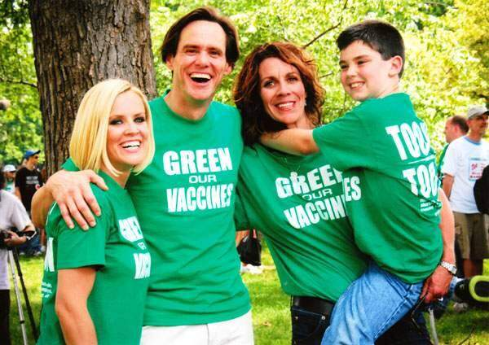
Harms of False Balance
1. Giving invalid or vague ideas equal weight to established and verifiable scientific facts by including both.
Example: Interviewing movie stars who use the slogan "green our vaccines" alongside a person with a doctorate in immunology discussing the safety of vaccines. This makes it appear as though their positions are equally valid.
Notes:
#1 Giving invalid or vague ideas equal weight to verifiable scientific facts
Example: Interviewing movie stars who use the slogan "green our vaccines" alongside a person with a doctorate in immunology discussing the safety of vaccines. This makes it appear as though their positions are equally valid.

Slide 36
Harms of False Balance
2. Allowing the social controversy to seem larger than it actually is.
Example: Interviewing only parents who refuse vaccines for their children, even though well over 90% of parents do vaccinate their children
Notes:
#2 Allowing the social controversy to seem larger than it actually is
Example: Interviewing only parents who refuse vaccines for their children, even though well over 90% of parents do vaccinate their children

Slide 37
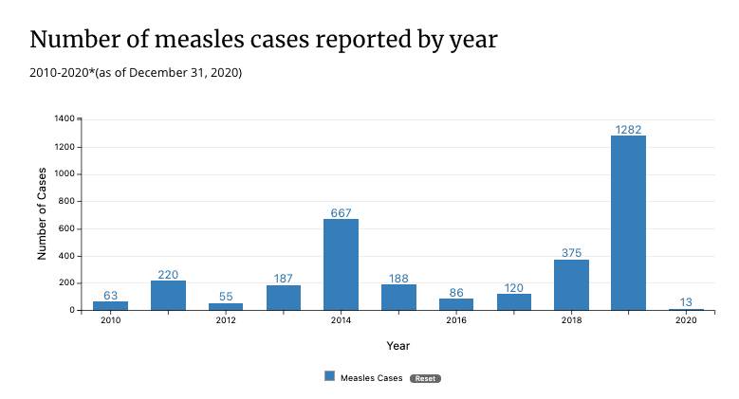
The cost of misrepresentation
Mis-representation can have dire consequences.
Here is an example.
Many people still believe false statements that autism is caused by the MMR (Measles, Mumps, Rubella) vaccine.
Sadly, this misinformation led to a decrease in MMR vaccination,
which led to a surge in measles cases,
which led to a lot of preventable hospitalizations.
Notes:
Mis-representation can have dire consequences. Here is an example.
Many people still believe false statements that autism is caused by measles-mumps-rubella vaccine (called MMR). It's been shown in many studies that this was unfounded.
Sadly, the misinformation led to a decrease in MMR vaccination, which led to a surge in measles cases, which led to a lot of preventable hospitalizations.

Slide 38
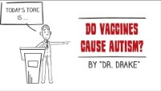
Vaccines and Autism: How the Myth Started
Notes:
Let’s watch the video for more information about this controversy. (4 minutes, 3 seconds)

Slide 39
When the anti-vaccine movement engages media
Human interest stories are an important facet of journalism but should not be used at the expense of verifiable fact.
False information and inaccuracies must be clearly highlighted by the reporter—not just by someone else featured in the piece.
Notes:
Human interest stories are an important facet of journalism, but should not be used at the expense of verifiable fact.
When personal experience contradicts scientific fact, and reporters feel compelled to include such a personal experience in a report, false information and inaccuracies must be clearly highlighted by the reporter not just by someone else featured in the piece.
Scientific consensus on the safety and effectiveness of vaccines is very solid. Yet we regularly see anti-vaccine activists featured in the media

Slide 40
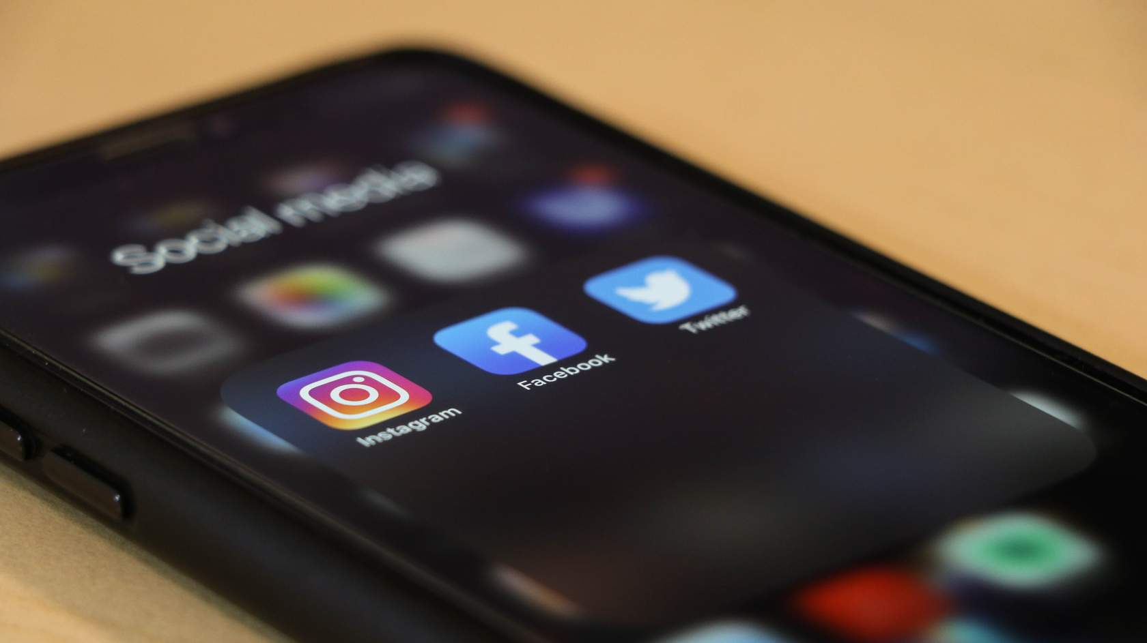
When the anti-vaccine movement engages media
Anti-vaccine activists want the media's attention because traditional and social media are the main tools they rely on to advance their ideas.
Notes:
Anti-vaccine activists want the media's attention because traditional and social media are the main tools they rely on to advance their ideas.

Slide 41
Evaluating Websites
Notes:
Anyone can start a website so it's important to evaluate websites before you rely on their information.
Many of the same considerations of media reports can be applied to online information.

Slide 42


Evaluating Websites
Anyone can start a website so it’s important to evaluate websites before you rely on their information.
Many of the same considerations of media reports can be applied to online information.
Notes:
Let's evaluate a U.S. immunization website, the Vaccine Education Center (VEC) at Children's Hospital of Philadelphia (CHOP), to see how they do.
Here's background on CHOP:
CHOP is a children's hospital in Philadelphia, Pennsylvania.
It is one of the largest and oldest children's hospitals in the world.
It is the United States' first hospital dedicated to the healthcare of children.
There are 5 sets of questions to ask yourself when evaluating a website.

Slide 43

Example
Let's evaluate a US immunization website, the Vaccine Education Center (VEC) at Children's Hospital of Philadelphia (CHOP).
URL: chop.edu/centers-programs/vaccine-education-center
Background on CHOP:
CHOP is a children's hospital in Philadelphia, Pennsylvania.
It is one of the largest and oldest children's hospitals in the world.
It is the United States' first hospital dedicated to the healthcare of children.
Notes:
Let's evaluate a U.S. immunization website, the Vaccine Education Center (VEC) at Children's Hospital of Philadelphia (CHOP), to see how they do.
Here's background on CHOP:
CHOP is a children's hospital in Philadelphia, Pennsylvania.
It is one of the largest and oldest children's hospitals in the world.
It is the United States' first hospital dedicated to the healthcare of children.
There are 5 sets of questions to ask yourself when evaluating a website.

Slide 44
Example
Let's evaluate a US immunization website, the Vaccine Education Center (VEC) at Children's Hospital of Philadelphia (CHOP).
URL: chop.edu/centers-programs/vaccine-education-center
There are 5 sets of questions to ask yourself when evaluating a website.
Notes:
Let's evaluate a U.S. immunization website, the Vaccine Education Center (VEC) at Children's Hospital of Philadelphia (CHOP), to see how they do.
Here's background on CHOP:
CHOP is a children's hospital in Philadelphia, Pennsylvania.
It is one of the largest and oldest children's hospitals in the world.
It is the United States' first hospital dedicated to the healthcare of children.
There are 5 sets of questions to ask yourself when evaluating a website.

Slide 45
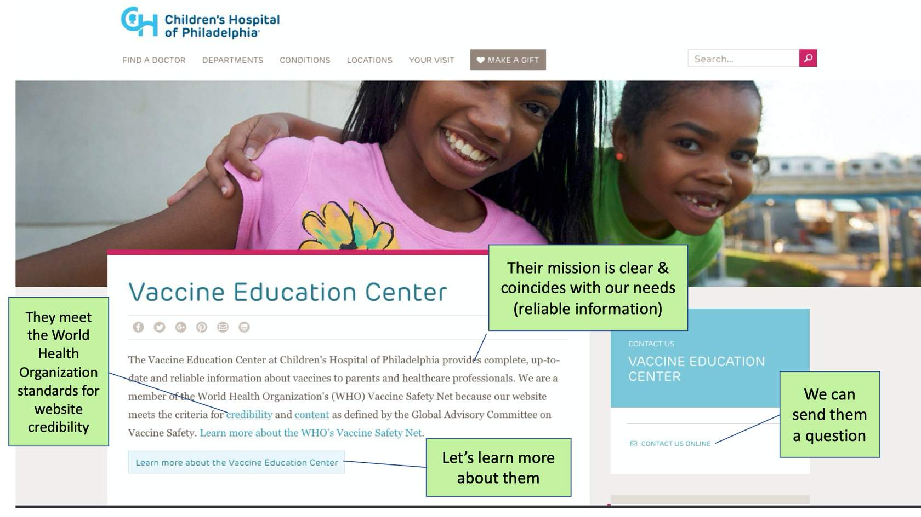
#1 Who does this website represent?
Let's look at the VEC home page.
Who oversees the website?
Why are they providing the site?
Can you contact them?
Notes:
Let's look at the VEC home page.
Who oversees the website?
Why are they providing the site?
Can you contact them?

Slide 46
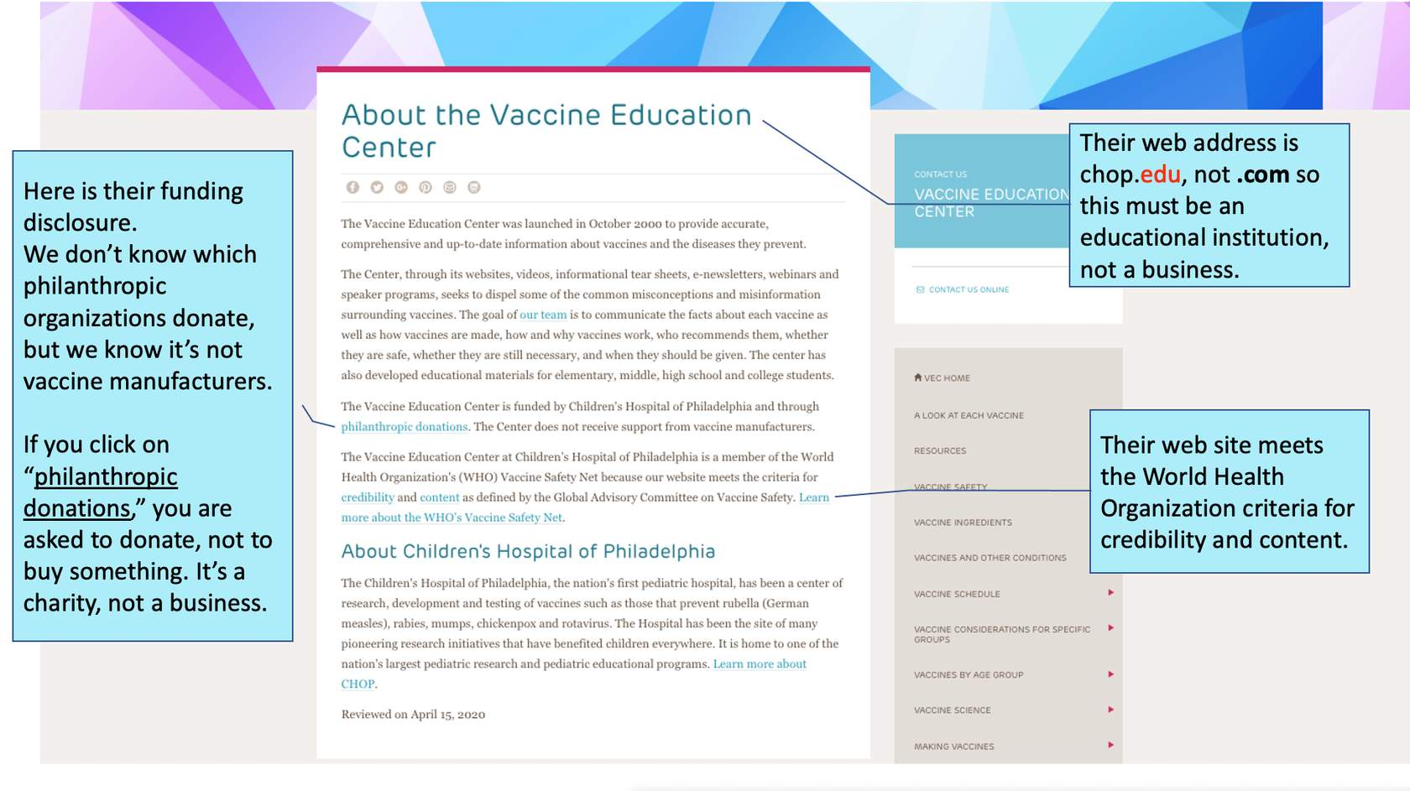
#2 Who funds the website?
Where does the money to support the site come from?
If the site has advertisements, are they labeled?
Link: About the Vaccine Education Center
Notes:
Where does the money to support the site come from?
If the site has advertisements, are they labeled?

Slide 47
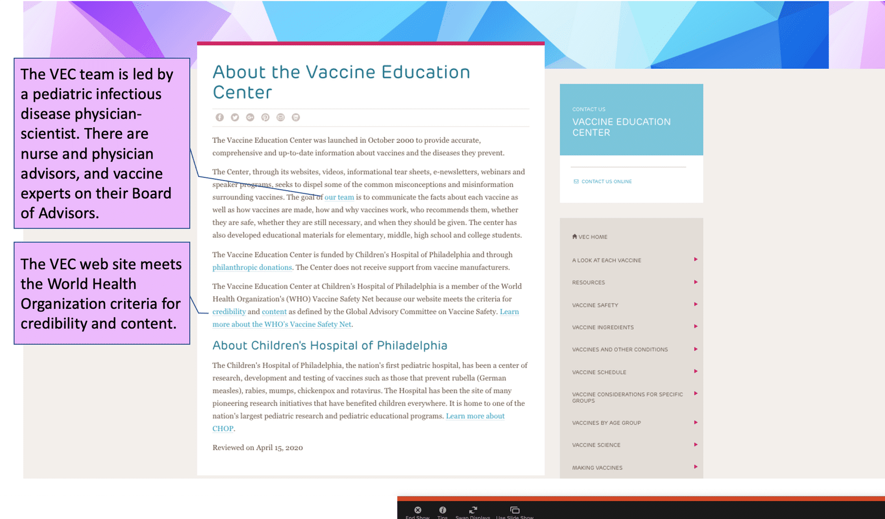
#3 What is the quality of the information?
Where does the information on the site come from?
How is the content selected?
Do experts review the information that goes on the site?
Does the site avoid unbelievable or emotional claims?
Is it up-to-date?
Notes:
Where does the information on the site come from?
How is the content selected?
Do experts review the information that goes on the site?
Does the site avoid unbelievable or emotional claims?
Is it up-to-date?
The Vaccine Education Center Director is a person with great expertise. Dr. Paul Offit is a Professor of Vaccinology and Pediatrics at the Perelman School of Medicine at the University of Pennsylvania.

Slide 48
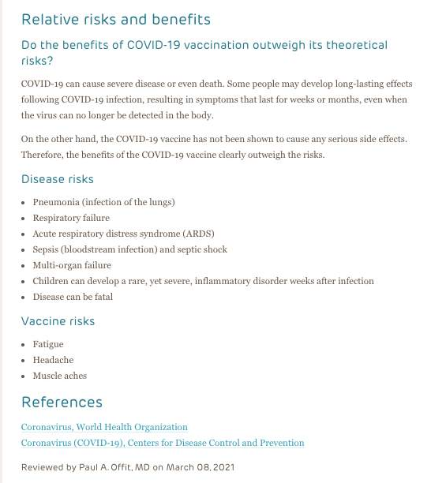
#4 Is the information up to date?
Timeliness matters. Medical science keeps evolving, so it's important to keep updating vaccine information.
Here we see that at the bottom of each page, VEC shows the date of its latest update.
Notes:
One component of quality is timeliness. Because medical science keeps evolving, it's important to keep updating vaccine information.
Here we see that at the bottom of each page with content, VEC shows the date of its latest update.

Slide 49
#5 How is the viewer's personal information used? (Privacy)
Does the site ask for your personal information?
Do they tell you how it will be used?
Are you comfortable with how it will be used?

Slide 50
Summary of questions to ask
Who does this website represent?
Who funds the website?
What is the quality of the information?
Is the information up to date?
How is the viewer's personal information used? (privacy)
Notes:
Here is a summary of the questions to ask when evaluating a website.

Slide 51
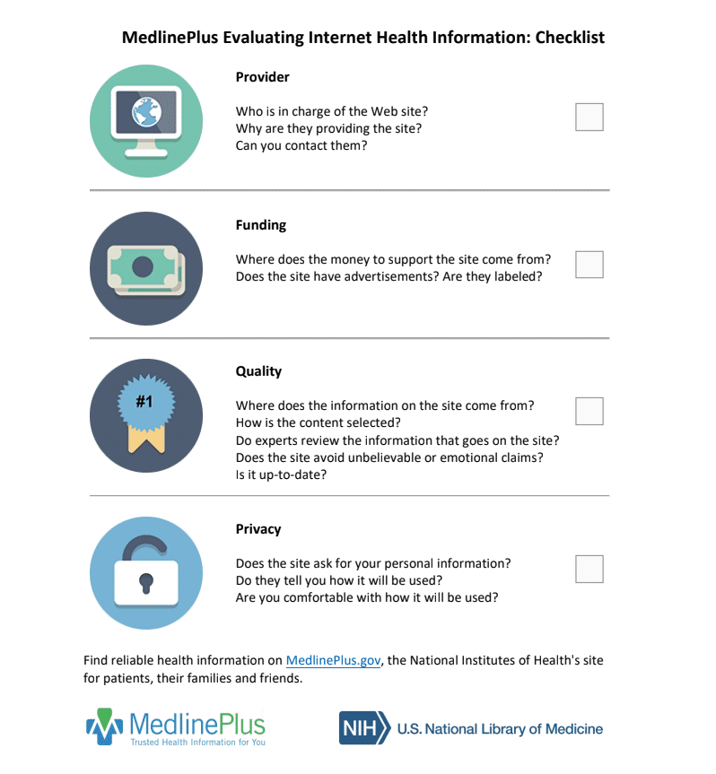
Notes:
More resources
https://drive.google.com/viewerng/viewer?url=https%3A//medlineplus.gov/webeval/EvaluatingInternetHealthInformationChecklist.pdf&embedded=true
The U.S. National Library of Medicine offers a full tutorial on "Evaluating Internet Health Information." Their 31-page guide available at https://medlineplus.gov/webeval/EvaluatingInternetHealthInformationTutorial.pdf

Slide 52
Quiz
Choose the statements below that would lead you to believe a website may NOT offer reliable information.
  The website has a shopping cart icon at the top of the page or multiple "add to cart" or "buy now" options.
  "This website is supported by Vitamins-R-Us, a company that produces vitamins for people everywhere.“
  "We do not give, share, sell, or transfer any personal information to a third party.“
  The website has a date for when the organization was established but no date for when the information was last reviewed.
Notes:
Choose the statements below that would lead you to believe a website MAY NOT OFFER RELIABLE INFORMATION (select all that apply).

Slide 53
Quiz
Choose the statements below that would lead you to believe a website may NOT offer reliable information.
  The website has a shopping cart icon at the top of the page or multiple "add to cart" or "buy now" options.
  "This website is supported by Vitamins-R-Us, a company that produces vitamins for people everywhere.“
  "We do not give, share, sell, or transfer any personal information to a third party.“
  The website has a date for when the organization was established but no date for when the information was last reviewed.

Slide 54
Evaluating Media Reports

Slide 55

Where do we get our information?
Sometimes it can seem like new information and research study results are coming out daily, and at times they directly conflict with other reports.
When evaluating a media report, you need to remember some essential things…
Notes:
Sometimes it can seem like new information and research study results are coming out daily, and at times they directly conflict with other reports.
When evaluating a media report, you need to remember some essential things.

Slide 56

Notes:
More resources
https://drive.google.com/viewerng/viewer?url=https%3A//medlineplus.gov/webeval/EvaluatingInternetHealthInformationChecklist.pdf&embedded=true
The U.S. National Library of Medicine offers a full tutorial on "Evaluating Internet Health Information." Their 31-page guide available at https://medlineplus.gov/webeval/EvaluatingInternetHealthInformationTutorial.pdf

Slide 57
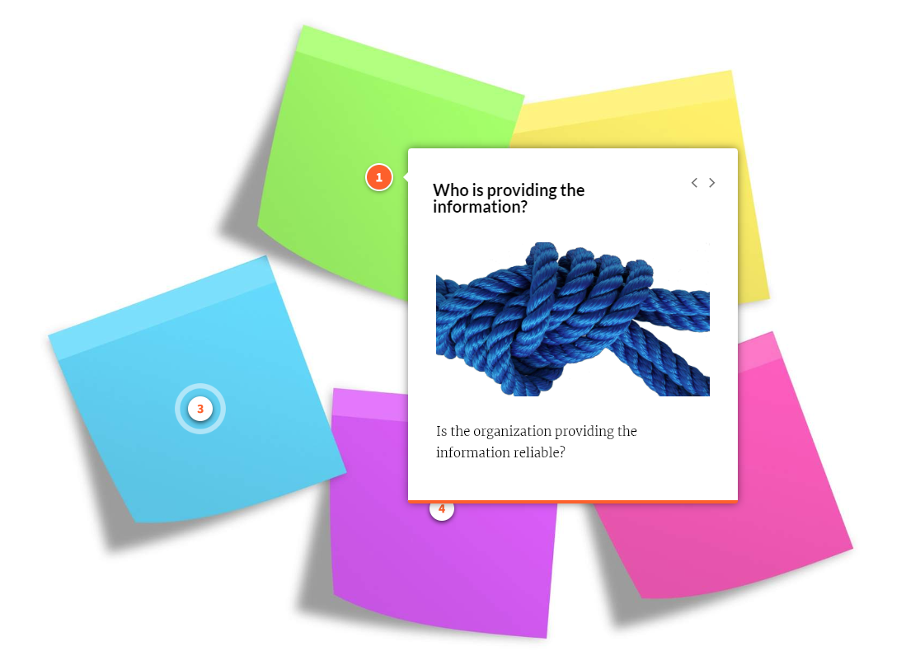
Notes:
More resources
https://drive.google.com/viewerng/viewer?url=https%3A//medlineplus.gov/webeval/EvaluatingInternetHealthInformationChecklist.pdf&embedded=true
The U.S. National Library of Medicine offers a full tutorial on "Evaluating Internet Health Information." Their 31-page guide available at https://medlineplus.gov/webeval/EvaluatingInternetHealthInformationTutorial.pdf

Slide 58
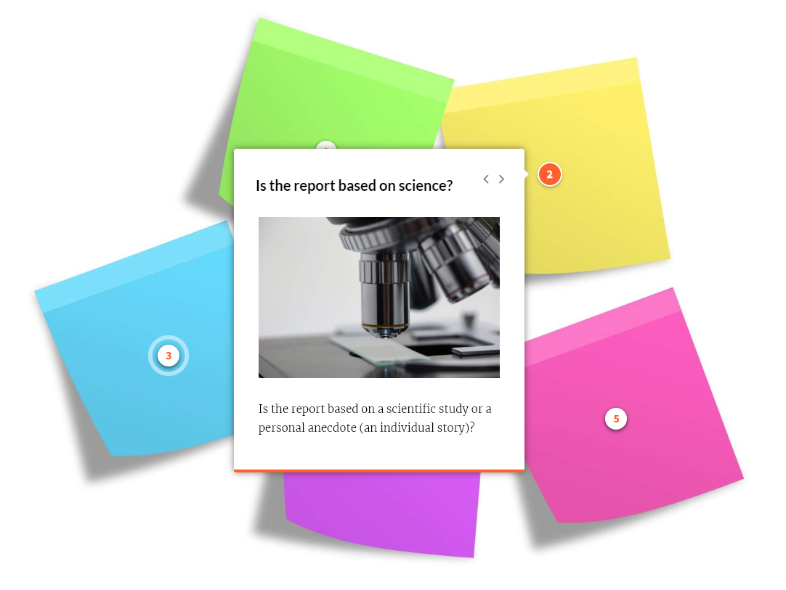
Notes:
More resources
https://drive.google.com/viewerng/viewer?url=https%3A//medlineplus.gov/webeval/EvaluatingInternetHealthInformationChecklist.pdf&embedded=true
The U.S. National Library of Medicine offers a full tutorial on "Evaluating Internet Health Information." Their 31-page guide available at https://medlineplus.gov/webeval/EvaluatingInternetHealthInformationTutorial.pdf

Slide 59
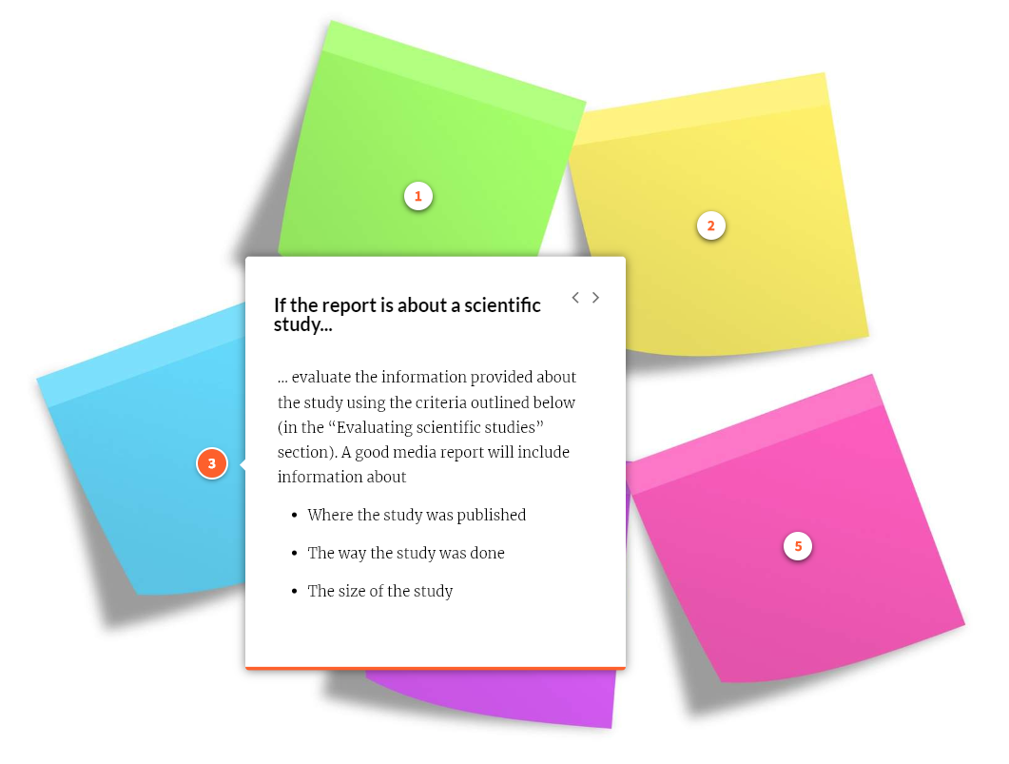
Notes:
More resources
https://drive.google.com/viewerng/viewer?url=https%3A//medlineplus.gov/webeval/EvaluatingInternetHealthInformationChecklist.pdf&embedded=true
The U.S. National Library of Medicine offers a full tutorial on "Evaluating Internet Health Information." Their 31-page guide available at https://medlineplus.gov/webeval/EvaluatingInternetHealthInformationTutorial.pdf

Slide 60
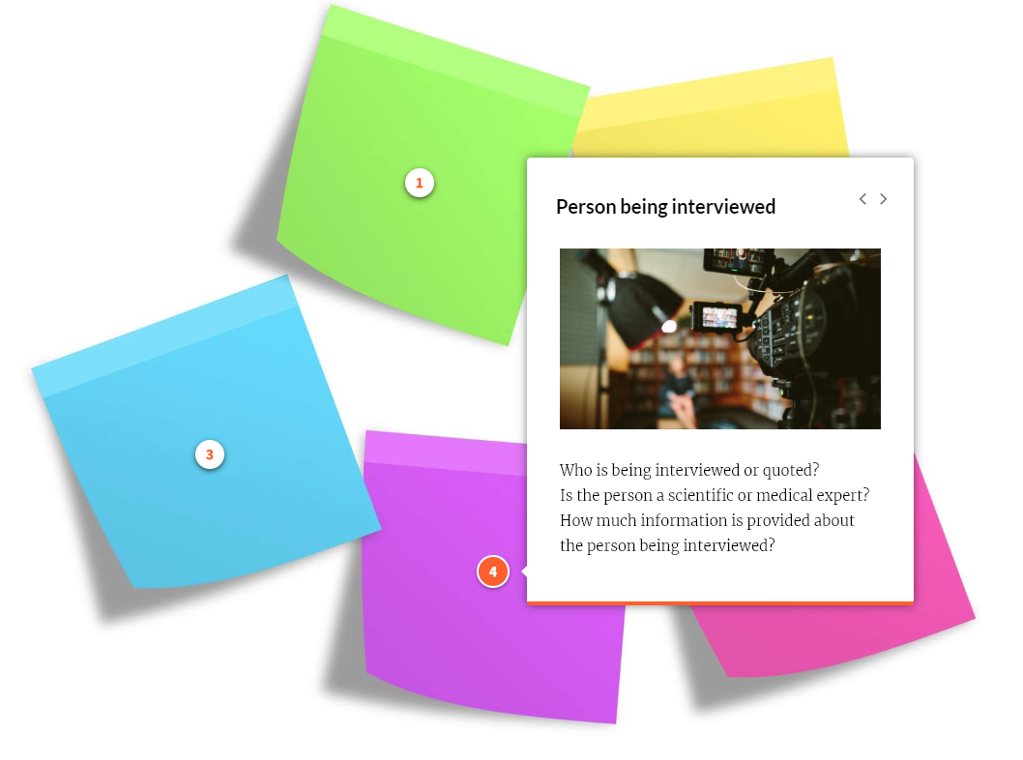
Notes:
More resources
https://drive.google.com/viewerng/viewer?url=https%3A//medlineplus.gov/webeval/EvaluatingInternetHealthInformationChecklist.pdf&embedded=true
The U.S. National Library of Medicine offers a full tutorial on "Evaluating Internet Health Information." Their 31-page guide available at https://medlineplus.gov/webeval/EvaluatingInternetHealthInformationTutorial.pdf

Slide 61
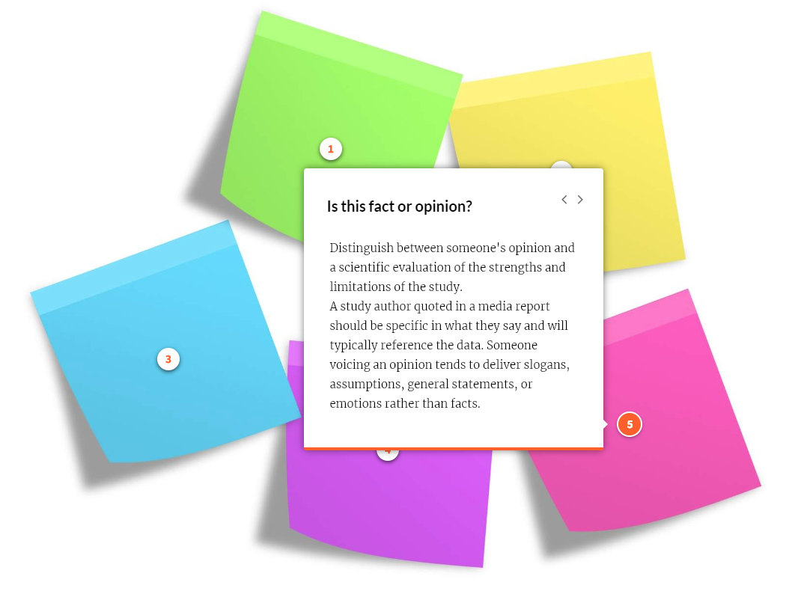
Notes:
More resources
https://drive.google.com/viewerng/viewer?url=https%3A//medlineplus.gov/webeval/EvaluatingInternetHealthInformationChecklist.pdf&embedded=true
The U.S. National Library of Medicine offers a full tutorial on "Evaluating Internet Health Information." Their 31-page guide available at https://medlineplus.gov/webeval/EvaluatingInternetHealthInformationTutorial.pdf

Slide 62
Evaluating scientific studies
Let's imagine a news story about drinking coffee.​
What the study showed: Drinking 80 oz of caffeinated coffee every day for 10 years leads to a two-fold increase in the risk of developing stomach cancer. ​
The press release from the Tea Grower's Society: “The study released today shows that drinking coffee can be associated with stomach cancer.”​
The headline reads: "Study shows coffee causes cancer!"
Notes:
Let's imagine a news story about a drinking coffee.
What the study showed: Drinking 80 oz of caffeinated coffee every day for 10 years leads to a two-fold increase in the risk of developing stomach cancer.
The press release from the Tea Grower's Society: “The study released today shows that drinking coffee can be associated with stomach cancer.”
The headline reads: "Study shows coffee causes cancer!"

Slide 63

Journalism caveats
Journalists often talk about presenting a balanced story.
However, there are a few caveats that are important to remember:
  Consider if this is scientifically-based information versus emotionally-based information.
  Consider the size and expertise of the group supporting each side of a story.
  Consider if the position of the story is supported by scientific bodies or other researchers in the field.
Notes:
Journalists often talk about presenting a balanced story. However, there are a few caveats that are important to remember:
If one is person is motivated by data and the other a personal experience, this is not balance. It is scientifically-based versus emotionally-based information.
Consider the size and expertise of the group supporting each side of a story.
Consider if the position of the story is supported by scientific bodies or other researchers in the field.
One of the tools that allows for successful ratings or increasing readership in the media is controversy. "Getting a reaction" out of readers may be more important to some media outlets than painting an accurate picture.

Slide 64
Wrap-up
Answer the questions to review what you learned!

Slide 65
Quiz
True or false?
At an 18-month doctor appointment, it's noticed that the child is not developing normal speech. After further tests and observation, the child is diagnosed with autism. The child had his MMR vaccine at 12 months of age. The fact that autism was diagnosed after the child got the MMR vaccine shows that autism is probably caused by MMR vaccine.
FALSE
Notes:
Answer: false
We humans are predisposed to see patterns and to gather information that supports our pre-existing views, a trait known as confirmation bias.
The child diagnosed with autism had many "exposures" before his diagnosis -- many of which we cannot sense (e.g., air pollution) or distinguish (e.g., viruses). There is no reason from this story to choose MMR vaccine as the villain.

Slide 66
Quiz
In respect to a health information website...
TRUE or FALSE: The sources for the information should be included.
TRUE or FALSE: It's fine for them to use your personal info without disclosing this.
TRUE or FALSE: The focus should NOT be selling you a product.
TRUE or FALSE: A section should explain who oversees the website.
TRUE or FALSE: The funding source should be kept anonymous
Notes:
True, false, true, true, false.

Slide 67
Quiz
In respect to a health information website...
TRUE or FALSE: The sources for the information should be included.
TRUE or FALSE: It's fine for them to use your personal info without disclosing this.
TRUE or FALSE: The focus should NOT be selling you a product.
TRUE or FALSE: A section should explain who oversees the website.
TRUE or FALSE: The funding source should be kept anonymous.
Notes:
True, false, true, true, false.

Slide 68


Quiz
Match the term with the definition.
A good media or scientific report False Balance
may contain this
Reporters giving both sides of a Where a study was done,
story can cause this how it was done, and size
A bad media report may only Personal anecdotes
contain this
Notes:
Answers:
A good media or scientific report contains where a study was done, how it was done, and the size of it.
Reporters giving both sides of a story can cause false balance
A bad media report may only contain personal anecdotes

Slide 69
Quiz
True or false?
You can find reliable health information on medlineplus.gov
TRUE
Notes:
Answer: TRUE. The medlineplus.gov(opens in a new tab) website includes clear information about:
The provider - the National Library of Medicine, the world's largest medical library
Funding - the U.S. government
Information quality - see https://medlineplus.gov/about/general/reviewandupdate/(opens in a new tab)
Privacy - see https://www.nlm.nih.gov/web_policies.html

Slide 70
Resources

Slide 71
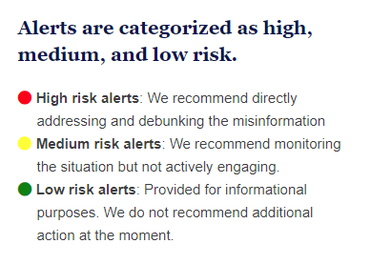
Misinformation Alerts
These insights are based on a combination of automated media monitoring and manual review by public health data analysts.
Media data are publicly available data from many sources, such as social media, broadcast television, newspapers and magazines, news websites, online video, blogs, and more.
See Misinformation Alerts at:
publichealthcollaborative.org/misinformation-alerts/
Notes:
Knowing what misinformation is being shared can help you generate effective messaging.
These insights are based on a combination of automated media monitoring and manual review by public health data analysts. Media data are publicly available data from many sources, such as social media, broadcast television, newspapers and magazines, news websites, online video, blogs, and more. Analysts from the Public Good Projects triangulate this data along with other data from fact checking organizations and investigative sources to provide an accurate, but not exhaustive, list of currently circulating misinformation.
See Misinformation Alerts at https://publichealthcollaborative.org/misinformation-alerts/

